Slide 1
Data Manipulation & Regex

Slide 2
What..?
Often in PHP we have to get data from files, or maybe through forms from a user.
Before acting on the data, we:
  Need to put it in the format we require.
  Check that the data is actually valid.

Slide 3
What..?
To achieve this, we need to learn about PHP functions that check values, and manipulate data.
  Input PHP functions.
  Regular Expressions (Regex).

Slide 4
PHP Functions
There are a lot of useful PHP functions to manipulate data.
We’re not going to look at them all – we’re not even going to look at most of them…
http://php.net/manual/en/ref.strings.php
http://php.net/manual/en/ref.ctype.php
http://php.net/manual/en/ref.datetime.php

Slide 5
Useful Functions: splitting
Often we need to split data into multiple pieces based on a particular character.
Use explode().
// expand user supplied date..
$input = ‘1/12/2007’;
$bits = explode(‘/’,$input);
// array(0=>1,1=>12,2=>2007)

Slide 6
Useful functions: trimming
Removing excess whitespace..
Use trim()
// a user supplied name..
$input = ‘ Rob ’;
$name = trim($input);
// ‘Rob’

Slide 7
Useful functions: string replace
To replace all occurrences of a string in another string use str_replace()
// allow user to user a number
of date separators
$input = ’01.12-2007’;
$clean = str_replace(array(‘.’,’-’),
‘/’,$input);
// 01/12/2007

Slide 8
Useful functions: cAsE
To make a string all uppercase use strtoupper().
To make a string all uppercase use strtolower().
To make just the first letter upper case use ucfirst().
To make the first letter of each word in a string uppercase use ucwords().

Slide 9
Useful functions: html sanitise
To make a string “safe” to output as html use htmlentities()
// user entered comment
$input = ’The <a> tag & ..’;
$clean = htmlentities($input);
// ‘The &lt;a&gt; tag &amp; ..’

Slide 10
More complicated checks..
It is usually possible to use a combination of various built-in PHP functions to achieve what you want.
However, sometimes things get more complicated. When this happens, we turn to Regular Expressions.

Slide 11
Regular Expressions
Regular expressions are a concise (but obtuse!) way of pattern matching within a string.
There are different flavours of regular expression (PERL & POSIX)

Slide 12

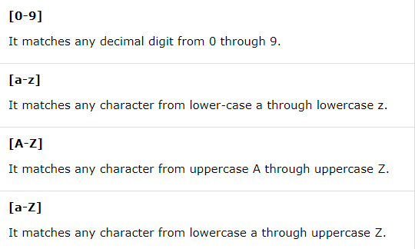
POSIX Regular Expression

Slide 13
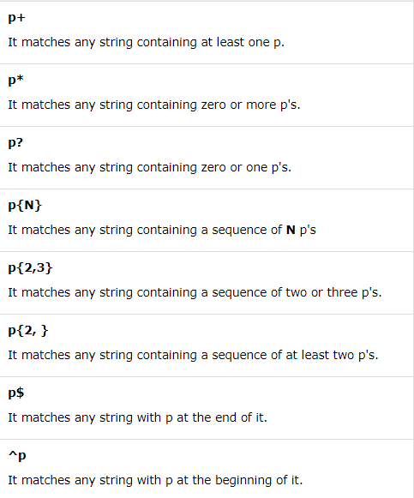
POSIX Regular Expression

Slide 14
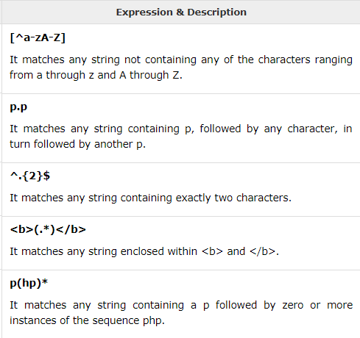
POSIX Expression Examples

Slide 15
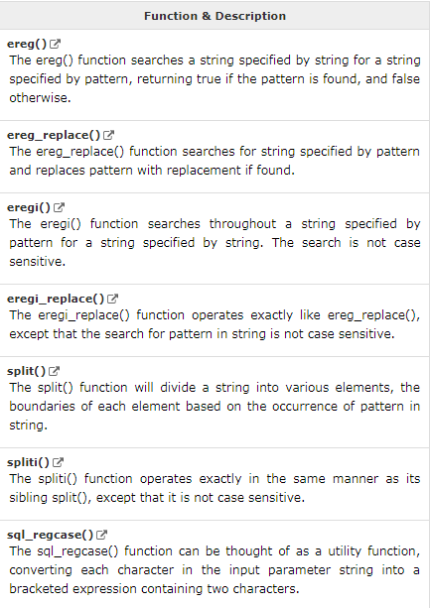
PHP’s POSIX Regexp Functions

Slide 16
Example
<?php
$email_id = "admin@tutorialspoint.com";
$retval = ereg("(\.)(com$)", $email_id);
if( $retval == true )
{ echo "Found a .com<br>"; }
else { echo "Could not found a .com<br>"; }
$retval = ereg(("(\.)(com$)"), $email_id, $regs);
if( $retval == true )
{ echo "Found a .com and reg = ". $regs[0]; }
else { echo "Could not found a .com"; }
?>

Slide 17
Some definitions
Actual data that we are going to work upon (e.g. an email address string)
‘rob@example.com’
'/^[a-z\d\._-]+@([a-z\d-]+\.)+
[a-z]{2,6}$/i‘
preg_match(), preg_replace()
PHP functions to do something with data and regular expression.
Definition of the string pattern (the ‘Regular Expression’).

Slide 18
PERL style Regular Expressions
'/^[a-z\d\._-]+@([a-z\d-]+\.)+[a-z]{2,6}$/i‘
Are complicated!
They are a definition of a pattern. Usually used to validate or extract data from a string.

Slide 19
Regex: Delimiters
The regex definition is always bracketed by delimiters, usually a ‘/’:
$regex = ’/php/’;
Matches: ‘php’, ’I love php’
Doesn’t match: ‘PHP’
‘I love ph’

Slide 20
Regex: First impressions
Note how the regular expression matches anywhere in the string: the whole regular expression has to be matched, but the whole data string doesn’t have to be used.
It is a case-sensitive comparison.

Slide 21
Regex: Case insensitive
Extra switches can be added after the last delimiter. The only switch we will use is the ‘i’ switch to make comparison case insensitive:
$regex = ’/php/i’;
Matches: ‘php’, ’I love pHp’,
‘PHP’
Doesn’t match: ‘I love ph’

Slide 22
Regex: Character groups
A regex is matched character-by-character. You can specify multiple options for a character using square brackets:
$regex = ’/p[hu]p/’;
Matches: ‘php’, ’pup’
Doesn’t match: ‘phup’, ‘pop’,
‘PHP’

Slide 23
Regex: Character groups
You can also specify a digit or alphabetical range in square brackets:
$regex = ’/p[a-z1-3]p/’;
Matches: ‘php’, ’pup’,
‘pap’, ‘pop’, ‘p3p’
Doesn’t match: ‘PHP’, ‘p5p’

Slide 24
Regex: Predefined Classes
There are a number of pre-defined classes available:
\d | Matches a single character that is a digit (0-9)
\s | Matches any whitespace character (includes tabs and line breaks)
\w | Matches any “word” character: alphanumeric characters plus underscore.

Slide 25
Regex: Predefined classes
$regex = ’/p\dp/’;
Matches: ‘p3p’, ’p7p’,
Doesn’t match: ‘p10p’, ‘P7p’
$regex = ’/p\wp/’;
Matches: ‘p3p’, ’pHp’, ’pop’
Doesn’t match: ‘phhp’

Slide 26
Regex: the Dot
The special dot character matches anything apart from line breaks:
$regex = ’/p.p/’;
Matches: ‘php’, ’p&p’,
‘p(p’, ‘p3p’, ‘p$p’
Doesn’t match: ‘PHP’, ‘phhp’

Slide 27
Regex: Repetition
There are a number of special characters that indicate the character group may be repeated:
? | Zero or 1 times
* | Zero or more times
+ | 1 or more times
{a,b} | Between a and b times

Slide 28
Regex: Repetition
$regex = ’/ph?p/’;
Matches: ‘pp’, ’php’,
Doesn’t match: ‘phhp’, ‘pap’
$regex = ’/ph*p/’;
Matches: ‘pp’, ’php’, ’phhhhp’
Doesn’t match: ‘pop’, ’phhohp’

Slide 29
Regex: Repetition
$regex = ’/ph+p/’;
Matches: ‘php’, ’phhhhp’,
Doesn’t match: ‘pp’, ‘phyhp’
$regex = ’/ph{1,3}p/’;
Matches: ‘php’, ’phhhp’
Doesn’t match: ‘pp’, ’phhhhp’

Slide 30
Regex: Bracketed repetition
The repetition operators can be used on bracketed expressions to repeat multiple characters:
$regex = ’/(php)+/’;
Matches: ‘php’, ’phpphp’,
‘phpphpphp’
Doesn’t match: ‘ph’, ‘popph’
Will it match ‘phpph’?

Slide 31
Regex: Anchors
So far, we have matched anywhere within a string (either the entire data string or part of it). We can change this behaviour by using anchors:
^ | Start of the string
$ | End of string

Slide 32
Regex: Anchors
With NO anchors:
$regex = ’/php/’;
Matches: ‘php’, ’php is great’,
‘in php we..’
Doesn’t match: ‘pop’

Slide 33
Regex: Anchors
With start and end anchors:
$regex = ’/^php$/’;
Matches: ‘php’,
Doesn’t match: ’php is great’,
‘in php we..’, ‘pop’

Slide 34
Regex: Escape special characters
We have seen that characters such as ?,.,$,*,+ have a special meaning. If we want to actually use them as a literal, we need to escape them with a backslash.
$regex = ’/p\.p/’;
Matches: ‘p.p’
Doesn’t match: ‘php’, ‘p1p’

Slide 35
So.. An example
Lets define a regex that matches an email:
$emailRegex = '/^[a-z\d\._-]+@([a-z\d-]+\.)+[a-z]{2,6}$/i‘;
Matches: ‘rob@example.com’,
‘rob@subdomain.example.com’
‘a_n_other@example.co.uk’
Doesn’t match: ‘rob@exam@ple.com’
‘not.an.email.com’

Slide 36
So.. An example
Starting delimiter, and start-of-string anchor
/^
[a-z\d\._-]+
@
([a-z\d-]+\.)+
[a-z]{2,6}
$/i
User name – allow any length of letters, numbers, dots, underscore or dashes
The @ separator
Domain (letters, digits or dash only). Repetition to include subdomains.
com,uk,info,etc.
End anchor, end delimiter, case insensitive

Slide 37
Phew..
So we now know how to define regular expressions. Further explanation can be found at:
http://www.regular-expressions.info/
We still need to know how to use them!

Slide 38
Boolean Matching
We can use the function preg_match() to test whether a string matches or not.
// match an email
$input = ‘rob@example.com’;
if (preg_match($emailRegex,$input) {
echo ‘Is a valid email’;
} else {
echo ‘NOT a valid email’;
}

Slide 39
Pattern replacement
We can use the function preg_replace() to replace any matching strings.
// strip any multiple spaces
$input = ‘Some comment string’;
$regex = ‘/\s\s+/’;
$clean = preg_replace($regex,’ ‘,$input);
// ‘Some comment string’

Slide 40
Sub-references
We’re not quite finished: we need to master the concept of sub-references.
Any bracketed expression in a regular expression is regarded as a sub-reference. You use it to extract the bits of data you want from a regular expression.
Easiest with an example..

Slide 41
Sub-reference example:
I start with a date string in a particular format:
$str = ’10, April 2007’;
The regex that matches this is:
$regex = ‘/\d+,\s\w+\s\d+/’;
If I want to extract the bits of data I bracket the relevant bits:
$regex = ‘/(\d+),\s(\w+)\s(\d+)/’;

Slide 42
Extracting data..
I then pass in an extra argument to the function preg_match():
$str = ’The date is 10, April 2007’;
$regex = ‘/(\d+),\s(\w+)\s(\d+)/’;
preg_match($regex,$str,$matches);
// $matches[0] = ‘10, April 2007’
// $matches[1] = 10
// $matches[2] = April
// $matches[3] = 2007

Slide 43
Back-references
This technique can also be used to reference the original text during replacements with $1,$2,etc. in the replacement string:
$str = ’The date is 10, April 2007’;
$regex = ‘/(\d+),\s(\w+)\s(\d+)/’;
$str = preg_replace($regex,
’$1-$2-$3’,
$str);
// $str = ’The date is 10-April-2007’

Slide 44
Phew Again!
We now know how to define regular expressions.
We now also know how to use them: matching, replacement, data extraction.

